Slide 1
Action Result
By default, the Controller actions will return the ActionResult object. We can return various types of results as ActionResult, which will decide how the output needs to render on the browser.
public ActionResult About()
{
return View();
}

Slide 2
Action Results Listing
View():- It represents an ASP.NET MVC view i.e. when you return HTML to the browser and it is the most common ActionResult returned by a Controller.
PartialView():- A fragment of an ASP.NET MVC view.
RedirectToAction():- Redirect from one controller action to a second controller action. Possible parameters that you can use with the RedirectToAction() methods are
E.g.
return RedirectToAction(“one”,”two”,”three”);
One :- actionName : The name of a controller action.
Two:- controllerName : Name of a Controller.
Three:- routeValues : The values passed to the action.

Slide 3
Redirect():- Redirection to another controller action or URL.
Content():- Raw content sent to the browser. There are multiple overloads of the Content() method. All the parameters are mentioned below that you can pass as an argument
string: The string to render to the browser.
contentEncoding: The text encoding of the content (e.g.:-Unicode or ASCII)
Json():- JavaScript object Notation (JSON). A lightweight alternative to XML appropriate for sending data across the internet in Ajax application. E.g :- You can convert a set of database records into a JSON representation and pass the data from the server to the browser.

Slide 4
data: The content to serialize.
contentType: The MIME type of the content (default to application/json).
contentEncoding: The text encoding of the content(e.g. Unicode or ASCII).
File():- Return a file from an action. E.g.: image file, word file etc.This method accepts the following parameters which are mentioned here: filename, contentType, fileDownloadName, fileContents [instead of providing the path to the file to download, you can provide the actual file contents as a byte array], fileStream.
JavaScript():- Represents a JavaScript file.

Slide 5
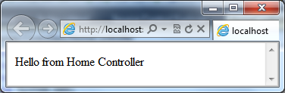
1. Content
When we need to return any text from a Controller action, we will use the Content type.
public ActionResult Index()
{
return Content("Hello from Home Controller");
}

Slide 6
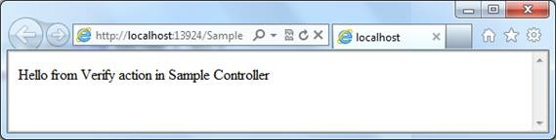
2. RedirectToAction
Depending on the input values, we can redirect to another Action. For redirecting to another Action, we will use the RedirectToAction type.
public ActionResult Index()
{
// Redirect to Verify action inside the Sample Controller
return RedirectToAction("Verify", "Sample");
}

Slide 7
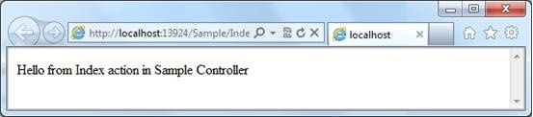
3. RedirectToRoute
When we need to redirect to a route defined in Global.asax, we will use the RedirectToRoute object.
As part of our sample application, we have a custom route defined with the name “sample”. This will route to the Index action inside the Sample Controller.
public ActionResult Index()
{
return RedirectToRoute("sample");
}

Slide 8
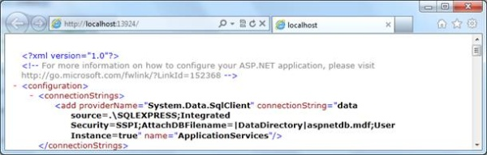
4.File
File is used to return the content of a file to the browser. For our sample, I am returning the web.config to the browser.
public ActionResult Index()
{
return File("Web.config", "text/html");
}

Slide 9
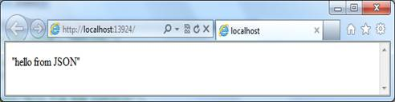
5.Json
We can render the text to the result page or can send it as a file to the client using JSON notation.
public ActionResult Index()
{
return Json("hello from JSON","text/html", JsonRequestBehavior.AllowGet);
}

Slide 10
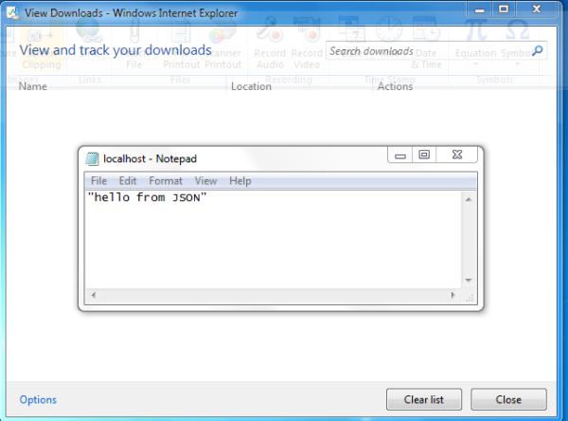
public ActionResult Index()
{
return Json("hello from JSON", JsonRequestBehavior.AllowGet);
}
If there is no content type specified, it will download the content as a file.

